Slide 1
EU Regulation 536 Jan 2022 Inregistrarea centrelor in sistemul EMA
Catalina Sarbu

Slide 2
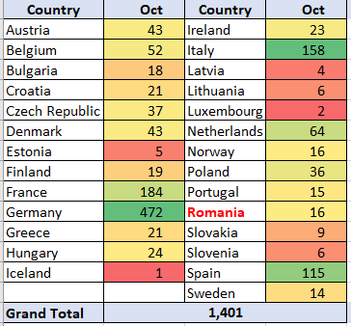
Sistemul electronic EMA (CTIS) La depunerea documentelor studiului in CTIS, se selecteaza tarile si centrele medicale => centrele trebuie sa fie acolo, in sistemul OMS pentru a putea fi selectate.

Slide 3
Inregistrarea in sistemul EMA (Organization Management System)
Inregistraea UTILIZATORULUI desemnat al institutiei in IAM (Identification and Account Management)
Go to: EMA Account Management (europa.eu) – create an account
Wait for the confirmation e-mail (credentials) before accessing other EMA applications
Inregistrarea INSTITUTIEI in OMS (Organization Management System) prin platforma numita SPOR
Go to SPOR platform SPOR Web UI (europa.eu) -> Login with your credentials obtained from IAM
Tab “Request new organization”
Supporting documents are necessary for the institution name and address: any document showing the official registration name and address, such as Hospital Accreditation, etc.)
wait for EMA validation; a confirmation for the request is provided by email. Timelines: 3-5 business days
Registration is completed when the site obtains the OMS ID numbers: OMS-Organisation-ID & OMS-Location-ID. ***Ex. Spitalul Judetean Craiova are: ORG-100033788 & LOC-100053153
*Duplicate!
*Numele institutiei recomandat in limba locala, ca in actele trimise => usureaza validarea
*Pasii in detaliu: document 3 pagini pe website AVANTYO si ACCSCR

Slide 4
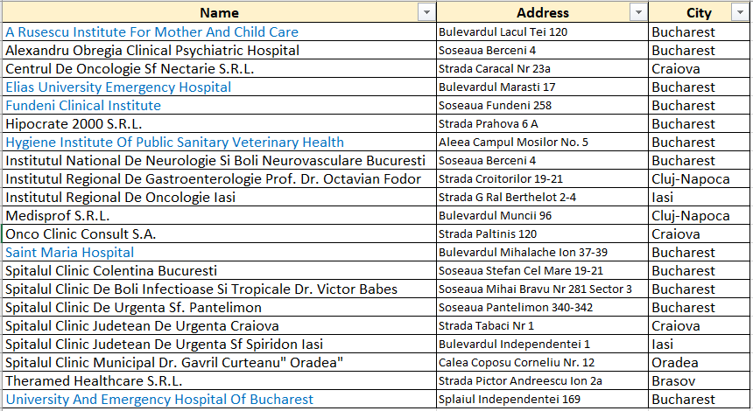
Centre medicale din Romania inregistrate in OMS- noiembrie 2021
.

